Slide 1
Strong Mayor Powers
Part VI.1 of the Municipal Act, 2001
Brent Larmer
Director, Legislative Services/ Town Clerk
Presentation to Council
April 30th 2025

Slide 2
Purpose of Presentation
To provide a high-level overview of the Strong Mayor Powers in Part VI.1 of the Municipal Act, 2001 and associated Regulations.
To provide an overview of Staff’s plan to review and integrate the Strong Mayor Powers into various by-laws. Policies and processes.
  Part VI.1 of the Act does not allow a municipality to “opt-out” of the Strong Mayor Powers
  Even if Strong Mayor Powers are never used, processes must align with new rules where necessary.
Notes:
This presentation will not discuss the merits of the Strong Mayor Powers

Slide 3
Strong Mayor Powers Legislation and Regulation
Bill 3, Strong Mayors, Building Homes Act, 2022, received Royal Assent on September 8, 2022.
Bill 3 added “Part VI.1 – Special Powers and Duties of the Head of Council – to the Municipal Act, 2001
  Part VI.1 are the rules commonly referred to as Strong Mayor Powers
Bill 39, The Better Municipal Governance Act, 2022, received Royal Assent on December 8, 2022
  Amended Part VI.1 of the Municipal Act, 2001
  Enhanced mayoral powers to propose and amend certain by-laws related to prescribed provincial priorities.

Slide 4
Strong Mayor Powers Legislation and Regulation
Ontario Regulation 530/2022
Designates Municipalities subject to Part VI.1 of the Municipal Act, 2001
On April 9th 2025, the Ministry of Municipal Affairs and Housing has proposed amendments to O. Reg. 530/22 under the Municipal Act, 2001 to expand the list of municipalities where the HOC has strong mayor powers and duties, to include certain single-tier and lower-tier municipalities with a council composition size of six members or more, to help these municipalities move forward on shared provincial-municipal priorities.
Currently the framework applies to 47 municipalities - the City of Toronto and 46 municipalities designated under O. Reg. 530/22 under the Municipal Act, 2001.
As of May 1, 2025, Town of Cobourg and 168 additional municipalities to have Strong Mayors in effect

Slide 5
Strong Mayor Powers Legislation and Regulation
Ontario Regulation 580/2022
Designates application to specific provisions of Part VI.2 Re. Meetings, veto powers, by-laws
Prescribed Provincial Priorities:
  Building 1.5 Million new residential units by December 31, 2031.
  Constructing and maintaining infrastructure to support housing, including,
    Transit
    Roads
    Utilities, and
    Servicing

Slide 6
Existing Role of Council
Municipal Act, 2001:
Role of council
224 It is the role of council,
(a) to represent the public and to consider the well-being and interests of the municipality;
(b) to develop and evaluate the policies and programs of the municipality;
(c) to determine which services the municipality provides;
(d) to ensure that administrative policies, practices and procedures and controllership policies, practices and procedures are in place to implement the decisions of council;
(d.1) to ensure the accountability and transparency of the operations of the municipality, including the activities of the senior management of the municipality;
(e) to maintain the financial integrity of the municipality; and
(f) to carry out the duties of council under this or any other Act.

Slide 7
Existing Role of Head of Council
Municipal Act, 2001:
Role of head of council
225 It is the role of the head of council,
(a) to act as chief executive officer of the municipality;
(b) to preside over council meetings so that its business can be carried out efficiently and effectively;
(c) to provide leadership to the council;
(c.1) without limiting clause (c), to provide information and recommendations to the council with respect to the role of council described in clauses 224 (d) and (d.1);
(d) to represent the municipality at official functions; and
(e) to carry out the duties of the head of council under this or any other Act.
Head of council as chief executive officer
226.1 As chief executive officer of a municipality, the head of council shall,
(a) uphold and promote the purposes of the municipality;
(b) promote public involvement in the municipality’s activities;
(c) act as the representative of the municipality both within and outside the municipality, and promote the municipality locally, nationally and internationally; and
(d) participate in and foster activities that enhance the economic, social and environmental well-being of the municipality and its residents.

Slide 8
Strong Mayor Powers - Categories
The Strong Mayor Powers in Part VI.1 of the Act fall into three (3) broad categories:
Legislative Powers (advance or do not interfere with prescribe provincial priorities; cannot be delegated)
  Require Council to consider a matter at a Council meeting
  Require Council to vote on a by-law at a Council meeting
  Power to veto by-laws adopted at a Council meeting.
Administrative Powers (Can be delegated)
  Appoint or dismiss CAO and Heads of Divisions
  Determine administrative organizational structure
  Establish Council Committees and appoint Chairs/Vice-Chairs
Financial Powers (Cannot be delegated)
  Prepare and present annual budget by February 1 (otherwise forfeits annual budget to Council)
  Power to Veto Council amendments to annual budget (2/3 Council Vote to overturn Veto)
  Present in-year budget amendments if supplementary levy is required

Slide 9
Mayor Powers Quick Summary Legislative Titles:
Direction to Municipal Employees
Powers exercised in writing
Powers of Chief Administrative Officer
Powers re. Organizational Structure and Employment Matters
Powers re. Local Boards
Powers re. Committees
Provincial Priorities
Powers re. meetings
Powers re. By-laws
Veto Powers
Vacancy, Head of Council
Delegation
Immunity
Transition
Powers and duties re. Budget
Regulations

Slide 10
Direction to Municipal Employees/ Powers Exercised in Writing
Directions to Employees
Under this Part, Mayor may, in writing, exercise powers of the municipality to direct employees to:
  Undertake research and provide advice to the Mayor and municipality on polices and programs of the municipality or of the Mayor as they relate to the powers and duties under this Part.
  Carry out duties related to the exercise of power or performance of the duty, including implementing a decision made by the Mayor under this part.
Powers Exercised in Writing
Mayor powers exercised or preformed under this part shall be done in writing and in accordance with regulations, if any
Mayor shall in accordance with regulations, make any prescribed information and documents available to the public and to any prescribed person
  When directing Staff, Mayor shall, by next business day, provide written record of direction to the clerk;
  When exercising power or preforming duty under this part, Mayor shall, by next business day, provide written record to each Member of Council and the Clerk and made available the written record to the public

Slide 11
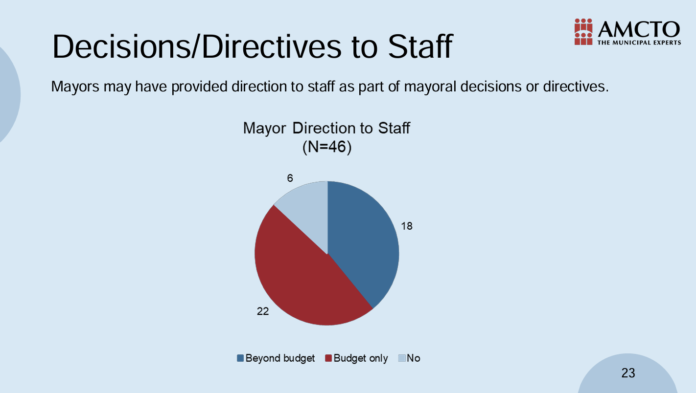
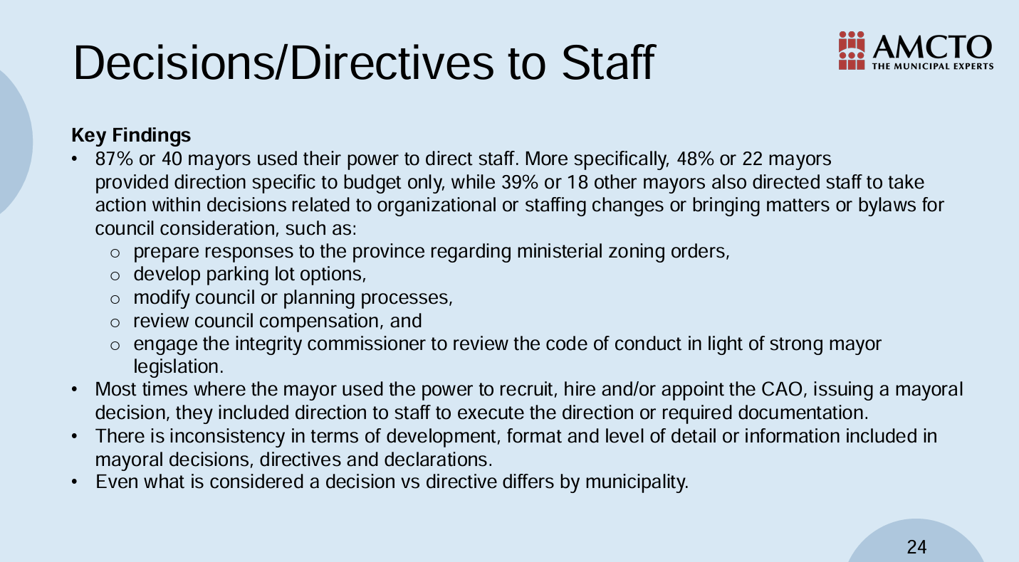

Slide 12
Powers of CAO
The Powers of the municipality, under section 229 re. CAO, are assigned to the Mayor:
Chief administrative officer
229 A municipality may appoint a chief administrative officer who shall be responsible for,
(a) exercising general control and management of the affairs of the municipality for the purpose of ensuring the efficient and effective operation of the municipality; and
(b) performing such other duties as are assigned by the municipality.

Slide 13
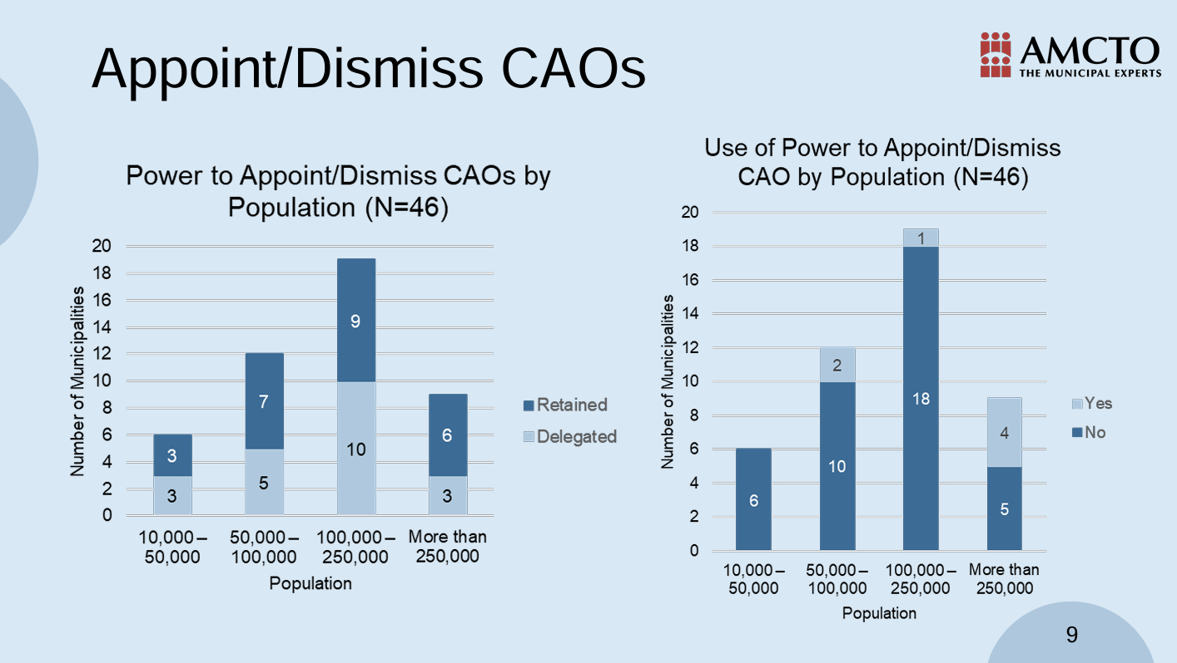
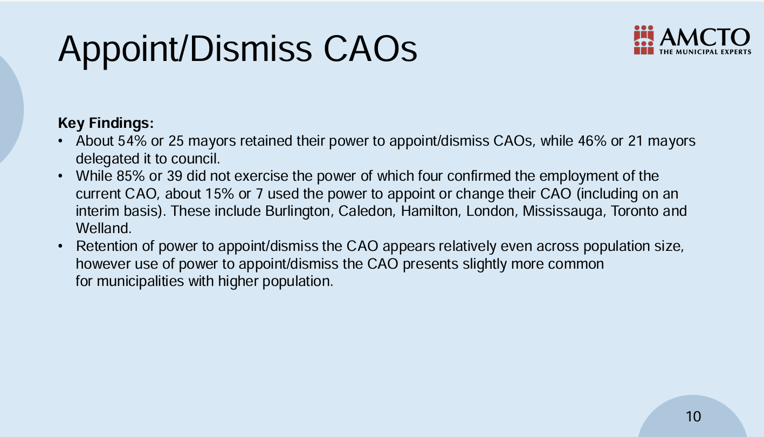

Slide 14
Powers re. Organizational Structure and Employment Matters
Powers of the Municipality re. determining organizational structure of the municipality are assigned to the Mayor
Subject to the regulations, includes powers to hire, dismiss or exercise any other prescribed employment powers for a head of a division or head of any part of the organization structure.
Powers do not apply to:
  Clerk/Deputy Clerk, Treasurer/Deputy Treasurer
  Integrity Commissioner, Ombudsman, Auditor General, Lobbyist Registrar
  Chief Building Official, Police Chief, Fire Chief, other officers or heads of divisions required to be appointed under legislation
  Other prescribed persons (none prescribed to date)
Any organizational structure in place in the municipality before designated under this part shall continue until changed by the Mayor
  Any head of any division or any other part of organizational structure in place before May 1, 2025
  Does not matter how long the person is employed,

Slide 15
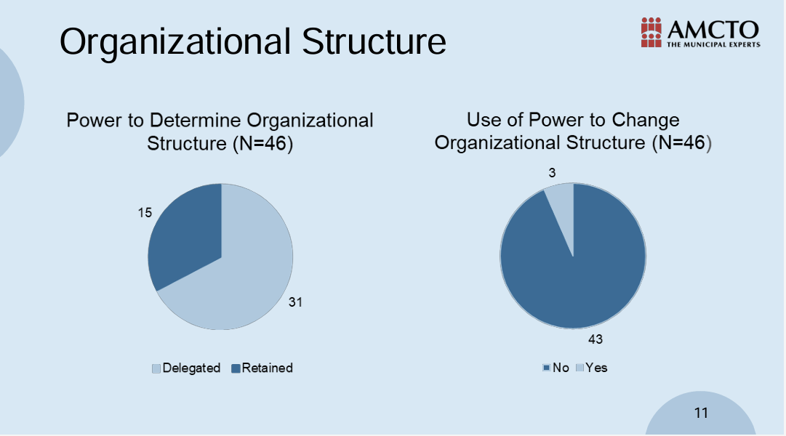
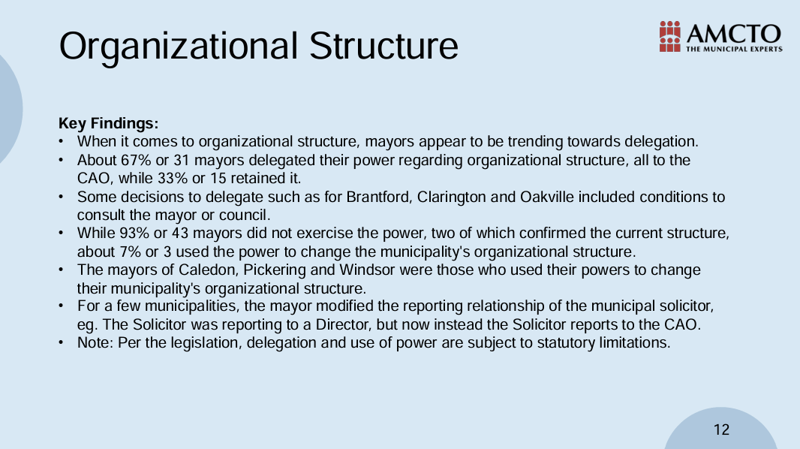

Slide 16
Local Boards
Powers of the municipality to appoint chairs and vice-chairs of local boards is assigned to the Mayor for any prescribed local board
  No local boards prescribed to date
Committees
Powers of the municipality assigned to the Mayor to:
  Establish or dissolve committees
  Appoint Chairs and Vice-Chairs of Committees
  Assign functions to committees
Powers apply only to committees established under the Municipal Act, 2001 that consist solely of Council Members

Slide 17
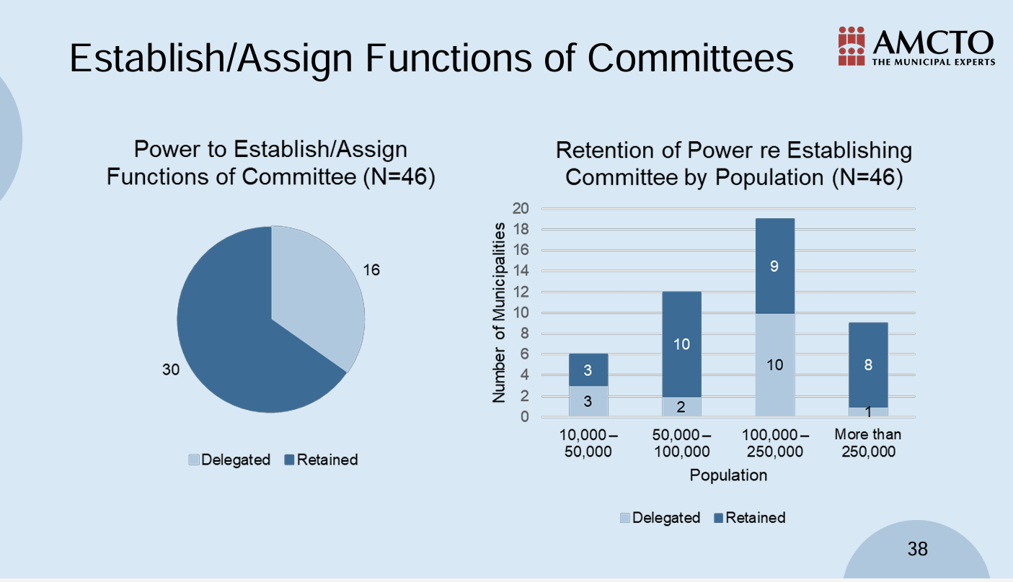
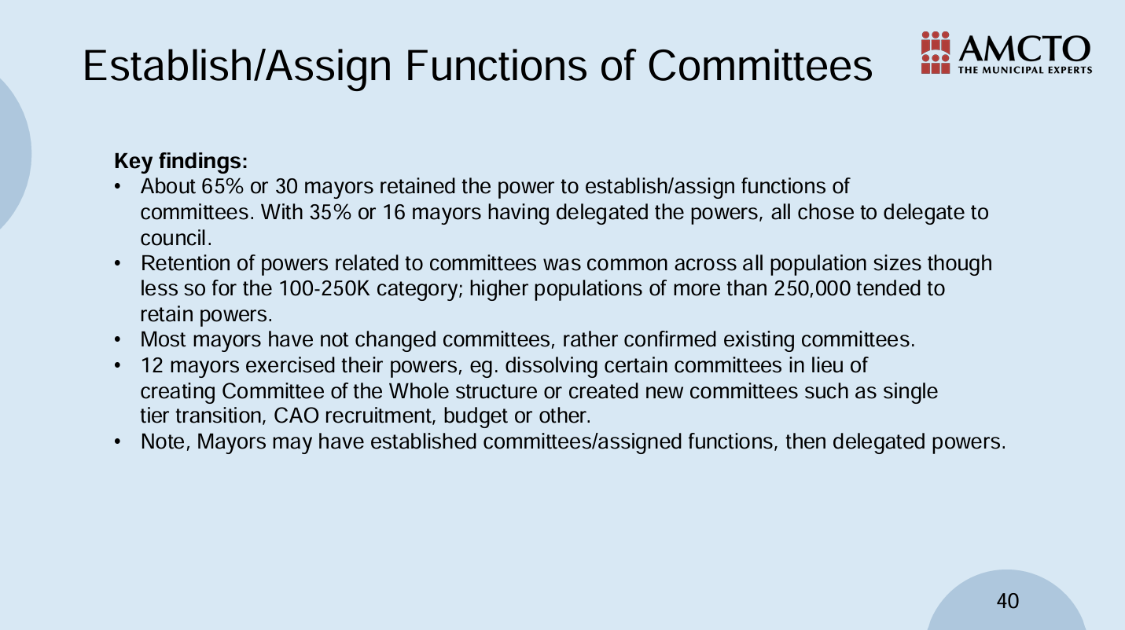

Slide 18
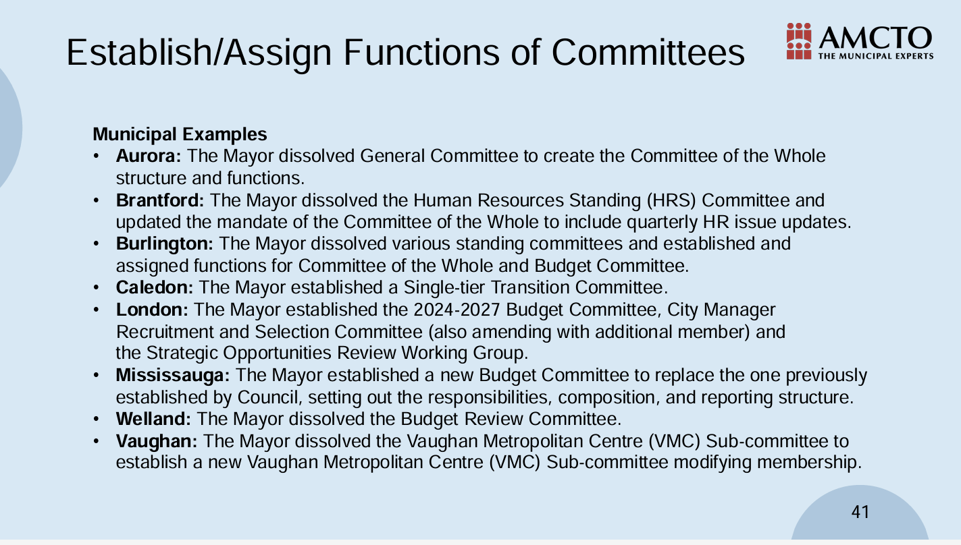

Slide 19
Provincial Priorities
Province, by regulation, prescribes provincial priorities for purposes of mayoral powers re. meetings, veto powers and by-laws
Mayoral powers re. meetings, veto powers and by-laws only apply if provincial priorities are prescribed.
Meetings
Regardless of the Town’s Procedural By-law rules, if the Mayor is of the opinion that considering a particular matter could potentially advance a prescribed priority, the Mayor may require the Council to consider the matter at a meeting defined by the Act.
“meeting” means any regular, special or other meeting of a council, of a local board or of a committee of either of them, where,
(a) a quorum of members is present, and
(b) members discuss or otherwise deal with any matter in a way that materially advances the business or decision-making of the council, local board or committee.

Slide 20
By-laws Powers
Applies to by-laws enacted under the Municipal Act, Planning Act and other Acts
  Includes by-laws issued under section 2 of the Development Charges Act, 1997,
  Does not include by-laws issued under sections 238, 263, 289 and 290 of the Act:
    Procedural By-law, filing vacancies
    Yearly budget, upper-tier municipalities and local municipalities.
Regardless of Procedure by-law rules, if the Mayor is of the opinion that a by-law could potentially advance a prescribed provincial priority, the Mayor may propose the by-law to Council and require Council to consider / vote on the by-law at a meeting.
Mayor shall, in accordance with the regulations, provide the Clerk and each Member of Council:
  A copy of the proposed by-law;
  The Mayors reasons for the proposed by-law
Regardless of the Procedure By-law rules, a proposed by-law from the Mayor is passed if more than 1/3 of the Members of Council vote in favour of the By-law
  Mayor may vote as a Member of Council in proposed by-law vote

Slide 21
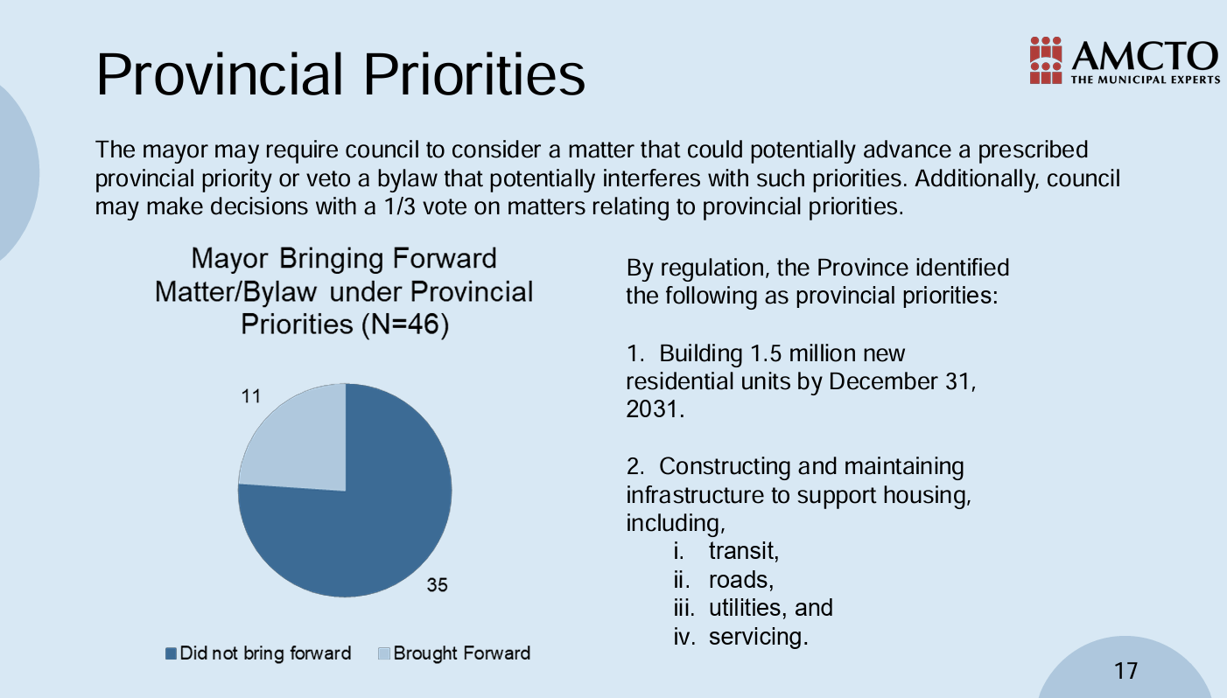

Slide 22
Veto Powers
The Strong Mayor Powers gives the Mayor veto power over certain by-laws:
  Under the Municipal Act, 2001
  Under the Planning Act
  Under other legislation prescribed in the regulations
    Exp. The Development Charges Act is prescribed legislation in O. Reg 530/22
Does not include by-laws issued under section 289 and 290 of Act:
  Yearly budget, upper-tier municipalities and local municipalities
Regardless of the Procedural By-law rules, if the Mayor is of the opinion that all or part of the by-law that is subject to this section could potentially interfere with a prescribed provincial priority, the Mayor may provide written notice to the Council of the intent to consider vetoing the by-law

Slide 23
Veto Powers – (Cont’d)
There is a process that must be followed to veto a by-law
After Council votes on a By-law, the Mayor must provide notice of intention to veto to the Clerk within two (2) days
  The Clerk is required to provide a copy of the notice of notice to Members of Council and the Public.
If the Mayor has given notice of intention to veto, within fourteen days of the Council Meeting, the Mayor is required to:
  Provide written approval of the by-law; or
  Veto the By-law in writing (a veto notice) with reasons
Within twenty-one (21) days of receiving the veto notice from the Clerk, Council can override the veto with a 2/3 vote
  The Mayor can vote on the proposal to override a veto.
If Members of Council want to override a veto this would have to be by:
  Members Motion at a Regular Council Meeting; or
  At a Special Council Meeting called by the Mayor or a Majority of Council for that purpose.

Slide 24
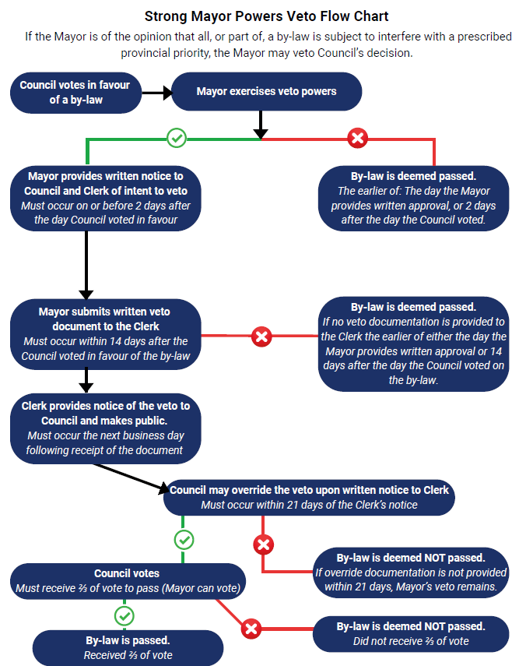

Slide 25
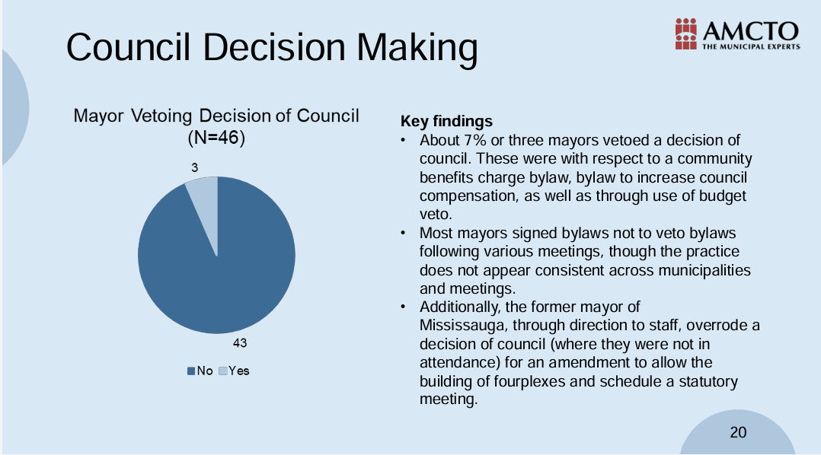

Slide 26
Vacancy of Mayor
Regardless of section 263 (Filling Vacancies) of the Act, if the Office of the Mayor is vacant, the municipality shall require a by-election to be held in accordance with the Municipal Elections Act
Rules for filling a vacancy for Office of the Mayor:
  Within 60 days after a declaration of vacancy is made under section 262 re. a vacancy, Council shall pass a by-law requiring a by-election to fill the vacancy
  If a court declares the Office of the Mayor Vacant, Council shall pass a by-law requiring a by-election to fill the vacancy
  If the vacancy occurs within 90 days before voting day in a regular election, Council is not required to fill the vacancy.
If the vacancy occurs after March 31 in the year of an Municipal Election:
  Within 60 days after a declaration of office is made under section 262, Council shall fill the vacancy by appointing a person who has consented to accept the Office of the Mayor and the municipality is not deemed to be prescribed for this Part for the remainder of the term of the appointed Office of the Mayor.

Slide 27
Delegation
Subject to prescribed limitations, the Mayor may delegate their powers and duties regarding:
  The powers and duties of the CAO. (s.284.5)
  The organizational structure (s.284.6)
  Local boards (s.284.8)
  Committees (s.284.8)
The Mayor may only delegate these powers to Council
The provisions of section 23.1 (2) of the Municipal Act apply to any delegation, and can is delegated to Council or the CAO

Slide 28
Immunity
A decision made, or veto power or other power exercised, legally and in good faith under this part, shall not be quashed or open to review by any court because of the unreasonableness of the decision or exercise of the veto power or other power.
Transition
A person who held one of the following positions before the municipality was designed under this part shall continue in that position unless they are dismissed or the appointment revoked by the Mayor:
  CAO
  Chair or vice-chair of a local board
  Chair or vice-chair of a committee

Slide 29
Budget
Under the Strong Mayor Powers, the Mayor is assigned the “powers and duties with respect to proposing and adopting a budget”
  Under Part VI.1 of the Act, Council does not approve the Town Budget – this responsibility now belongs to the Mayor.
O.Reg. 530/22 defines a process to approve budgets:
  The Mayor is required to provide a proposed budget to Council, the Clerk and the public by February 1 of each year
  If the Mayor does not propose a budget to Council by February 1, Council is responsible for preparing the Budget.

Slide 30
Budget
O.Reg. 530/22 defines a process to approve budgets:
  Within thirty (30) days of the Mayor proposing a budget, Council may pass resolutions amending the proposed budget
    Council may pass a resolution to shorten this thirty (30) day period
If Council does not pass resolutions amending the budget within the 30 days (or shorter period) if applicable, then the budget proposed by the Mayor is deemed adopted.
The mayor may veto any amendments approved by Council.
    Council can override the veto on a 2/3 vote.

Slide 31
Budget
O.Reg. 530/22 defines a process to approve budgets:
  Within ten (10) days after the expiry of the time period for Council to pass a resolution, the Mayor may veto a resolution pass by Council by providing on the day of the veto to each Member of Council and the Clerk a written veto document that includes the veto and reasons for the veto
      Mayor may, in a year, shorten the ten (10) day period to veto the resolution passed by Council, by providing to each member of Council and to the Clerk a written document specifying a shorter period.
If the Mayor vetoes a resolution passed by Council, the resolution shall be deemed not to have passed by Council.
If the Mayor does not veto a resolution within ten (10) days, or, if a shorter period is set, the proposed budget shall be deemed to be adopted by the municipality.
Within fifteen (15) days of the expiry of the time period for the Mayor to veto a resolution passed by Council, Council may override the Mayor’s veto if 2/3 of the Members of Council vote to override the veto (Mayor may Vote to override a veto)
    Council may pass a resolution to shorten the 15-day period
    If override vote carries, the resolution shall be deemed to be passed by Council
    After expiry of time period for council to override Mayor Veto, the proposed budget is deemed passed

Slide 32
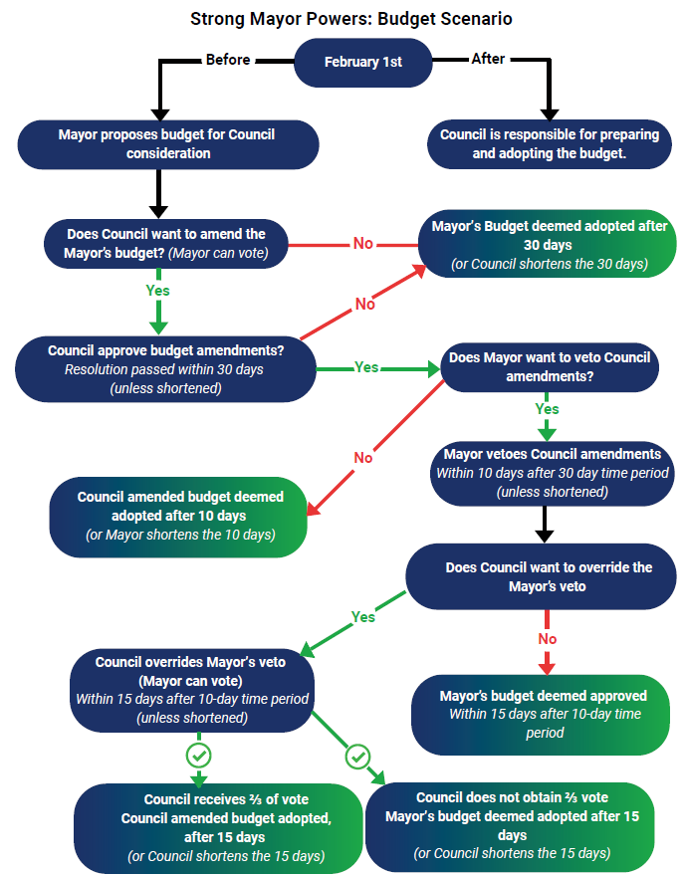

Slide 33
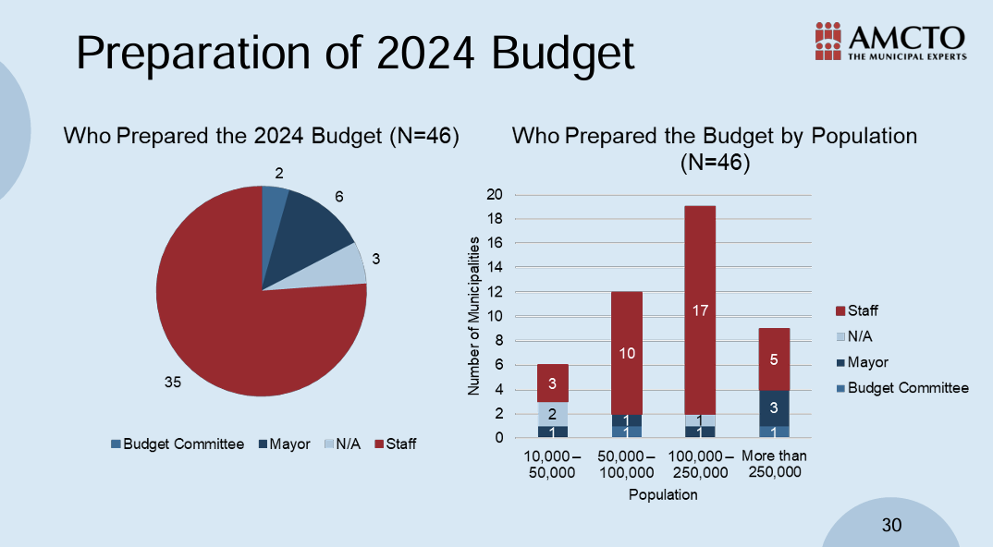

Slide 34
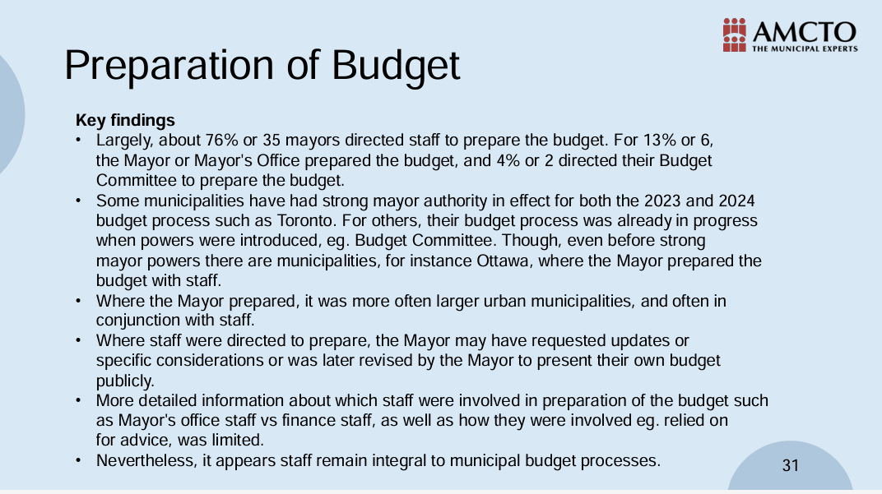

Slide 35
Budget – Conflict of Interest
If under section 5.3 of the Municipal Conflict of Interest Act, the Mayor is prohibited from using the power and exercising the duty to prepare the proposed budget with respect to a matter:
  Council may pass a resolution to amend the proposed budget with respect to the matter
  The Mayor may not veto the resolution.

Slide 36
Budget – In year Amendments
Mayor may for purpose of raising an additional general or special local municipal levy under section 312 of the Act, prepare a proposed budget amendment for the Town:
  Provide the proposed budget amendment to each member of Council and the clerk, and
  Make the proposed budget amendment available to the public
Within 21 days after receiving the proposed budget amendment from the Mayor, Council may pass a resolution making and amendment to the proposed budget amendment:
  Council may pass a resolution to shorten the 21 day period for the year
  If Council does not pass a resolution within 21 days, or if a shorter period is set, within that period, the proposed budget shall be deemed to be adopted.
Within 5 days after the expiry of the time period for Council to pass a resolution, the Mayor may veto a resolution passed by Council by providing on the day of the veto to each Member of Council and then Clerk a written veto document that includes the veto and the reasons for the veto

Slide 37
Budget – In year Amendments
Mayor may, in a year, shorten the five (5) day period for the year to veto the resolution passed by Council, by providing to each Member of Council and to the Clerk a written document specifying a shorter period
  If the Mayor vetoes a resolution passed by Council, the resolution shall be deemed not to have passed by Council
  If the Mayor does not veto a resolution with five (5) days or, if a shorter period is set, the proposed budget shall be deemed to be adopted by the municipality.
Within ten (10) days of the expiry of the time period for the Mayor to veto a resolution passed by Council, Council may override the Mayors veto if 2/3 of the Members of Council vote to override the veto (Mayor may vote in a vote to override the veto)
  Council may pass a resolution to shorten the ten (10) day period
  If override vote carries, the resolution shall be deemed to be passed by Council
  After the expiry of the time period for Council to override the Mayor’s veto, the proposed budget is deemed to be adopted by the Town.

Slide 38
Exercising Powers and Public Disclosure
All Strong Mayor Powers must be exercised in writing (i.e. Mayoral Decisions under Part VI.1 of the Act must be written and signed)
  Any Mayoral Decision under Part VI.1 of the Act must be made public.
Part VI.1 of the Act (the Strong Mayor Powers) apply to Cobourg as of May 1, 2025.
  The Town and Mayor cannot simply opt-out of these rules
A webpage on the Town’s Website to post Mayoral Decisions and Directives has been prepared and published – i.e. for Public Disclosure.
Strong Mayor Powers - Town of Cobourg
https://www.cobourg.ca/en/our-government/strong-mayor-powers.aspx

Slide 39
Next Steps
Over the Spring/Summer months, Staff will be reviewing By-law and Policies and practices to ensure consistency/compliance with the Strong Mayor Powers, following the May 1, 2025, expansion of the Strong Mayor Powers to Cobourg and when there is indication from the Head of Council on any use of the Strong Mayor Powers and any delegations.
THAT Council receives the staff report on Strong Mayor Powers overview to take effect in the Town of Cobourg on May 1, 2025 for information purposes; and
FURTHER THAT Council direct Staff to review the various Council, policies and by-laws now the Town of Cobourg is a Strong Mayor municipality and provide recommendations on amendments where necessary for Council review and consideration.
Recommendations:

Slide 40
Questions

