Slide 1
2024 Budget Community Engagement Results

Slide 2
By the Numbers
Aware Visitors: 634 (634 people visited the Engage Cobourg project page)
Informed Visitors: 492 (492 people visited the site and viewed the budget materials but did not complete the survey)
Engaged Visitors: 280 (280 people completed the survey)
2023 Budget Engagement: 181 Aware Visitors, 111 Informed, 70 Engaged
2024 Budget Community Engagement Results

Slide 3
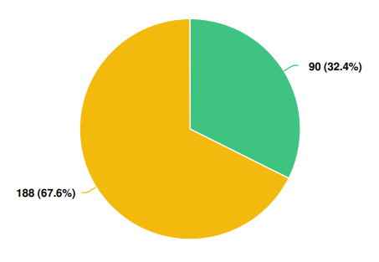
Demographics
Q: Have you participated in a Budget Survey in the past?
2024 Budget Community Engagement Results

Slide 4
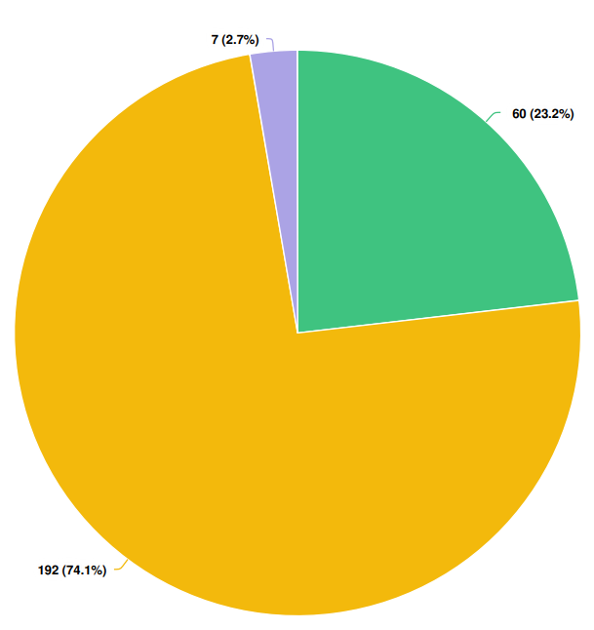
Demographics
Q: Do you currently have any children under the age of 18 living in your household?
2024 Budget Community Engagement Results

Slide 5
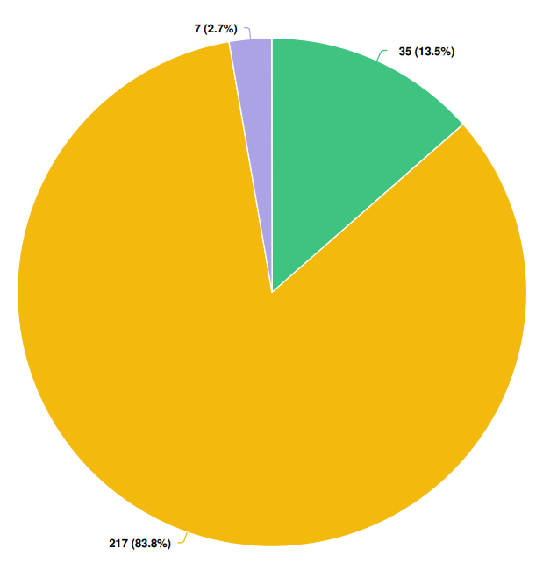
Demographics
Q: Multi-Generational Families: Currently, do you have any children over the age of 18 or other family members living in your household?
2024 Budget Community Engagement Results

Slide 6
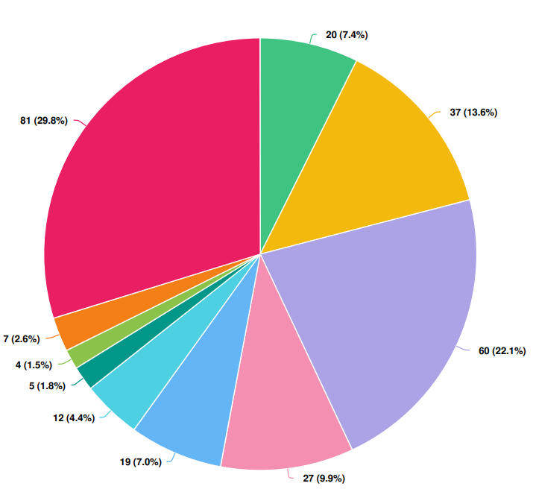
Demographics
Q: What is your household income?
7.4% - Less than $40,000
2.6% - $40,000 - $80,000
22.1% - $81,000 - $120,000
9.9% - $121,000 - $160,000
7% - $161,000 - $200,000
4.4% - 201,000 - $240,000
1.8% - $241,000 – $280,000
1.5% - $281,000 – $320,000
2.6% - $320,000+
2024 Budget Community Engagement Results

Slide 7
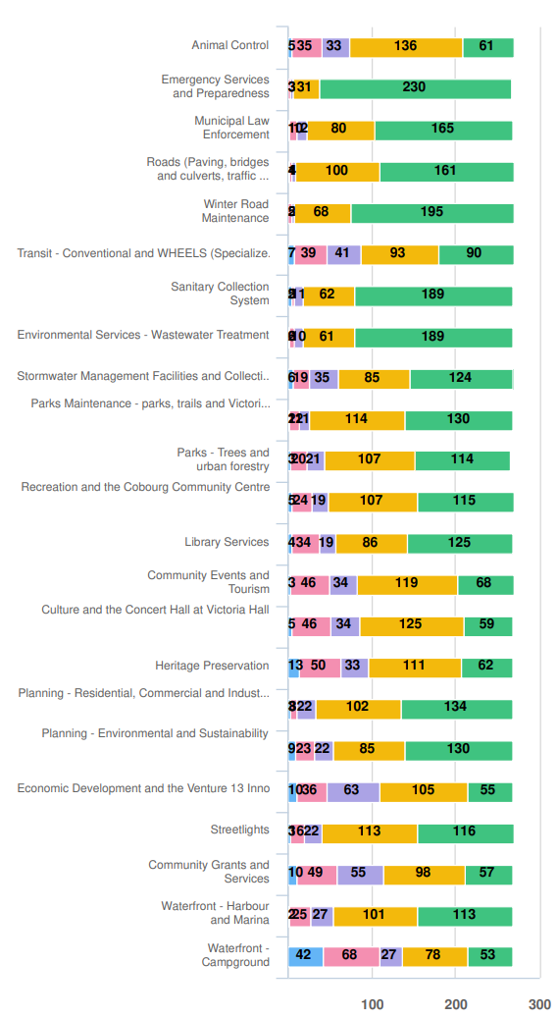
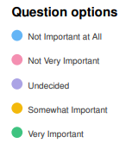
Satisfaction with Municipal Services
Q: How important do you think the following services and programs are to the community?
2024 Budget Community Engagement Results

Slide 8
Satisfaction with Municipal Services
Q: How important do you think the following services and programs are to the community?
Leading Services:
Emergency Services and Preparedness
Winter Road Maintenance
Environmental Services & Sanitary Collection System
Planning – Residential, Commercial and Industrial
Planning – Environmental & Sustainability
Parks Maintenance
Library Services
2024 Budget Community Engagement Results

Slide 9
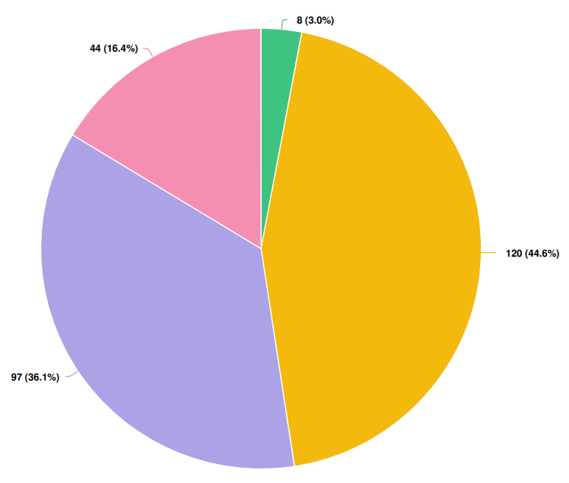
Satisfaction with Municipal Services
Q: Based on the programs and services provided by the Town of Cobourg, how satisfied are you with the overall value you receive for your tax dollars?
2024 Budget Community Engagement Results

Slide 10
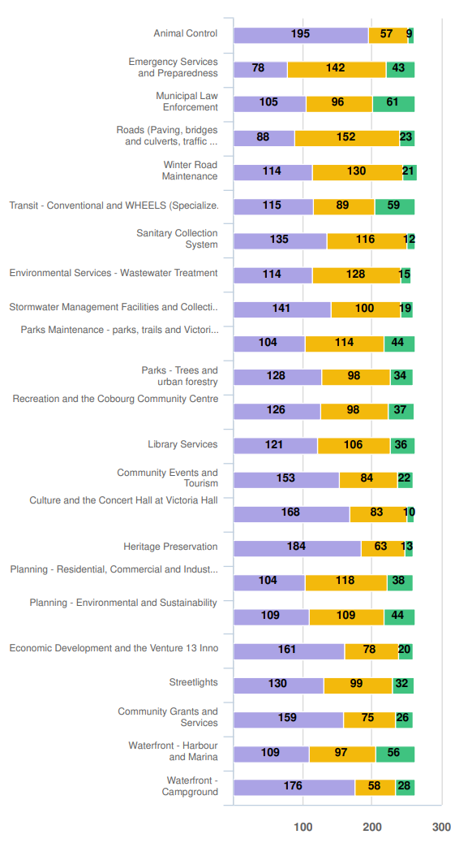
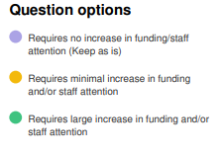
Satisfaction with Municipal Services
Q: Of the following programs and services, which do you believe need additional funding or staff attention?
2024 Budget Community Engagement Results

Slide 11
Satisfaction with Municipal Services
Q: Of the following programs and services, which do you believe need additional funding or staff attention?
Requires Increase in funding and/or staff attention:
Municipal Law Enforcement
Transit – Conventional and WHEELS
Waterfront – Harbour and Marina
Emergency Services and Preparedness
Parks Maintenance
Planning – Environmental and Sustainability
Planning – Residential and Commercial
Roads – Paving, bridges and culverts & Winter Road Maintenance
Library
Community Services and Recreation
2024 Budget Community Engagement Results

Slide 12
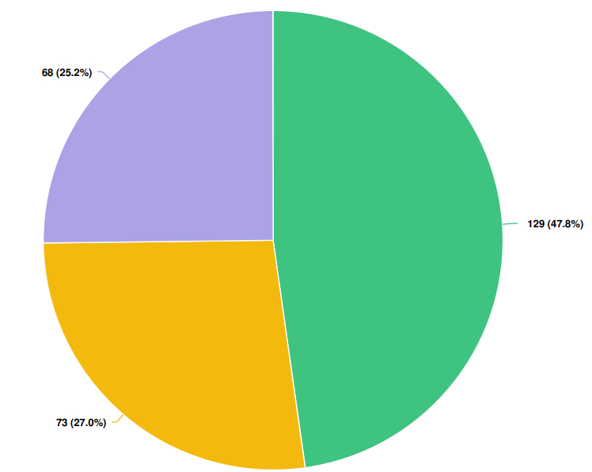
Key Budget Items – Transit
Q: Staff have presented a Limited Fixed Route Service Pilot Project as an option for a one-year trial.
Additional Operating Budget required to fund the Fixed Route Service: $175,000.
Do you believe a Fixed Route Service Pilot Project is a valuable service for the Town of Cobourg?
2024 Budget Community Engagement Results

Slide 13
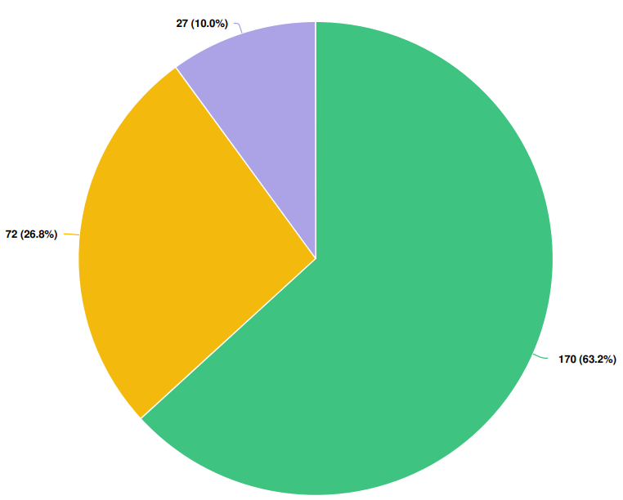
Key Budget Items – Centennial Pool
Q: Staff have recommended continuing the operation of the Centennial Pool for the 2024 summer season.
Operating budget required $139,529.
Do you believe this is a valuable service for the Town of Cobourg?
2024 Budget Community Engagement Results

Slide 14
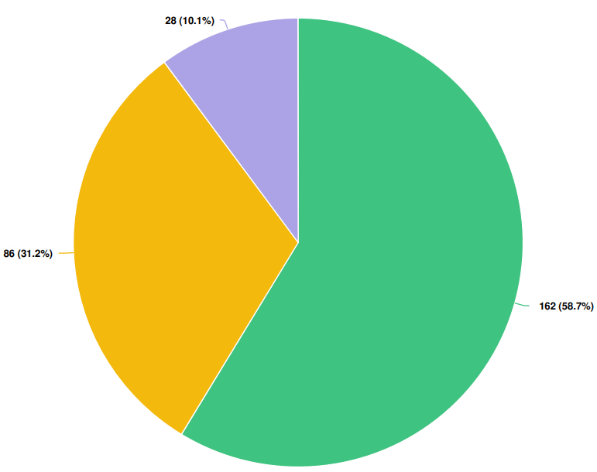
Key Budget Items – Centennial Pool
Q: The Centennial Pool is currently operating well beyond its expected lifespan and will require significant reconstruction work if it is to be kept operational. Staff have put a placeholder of $1.6 million into the 2025 Capital budget for renovations. In addition, the pool would require approximately $138,000 for annual operation. Do you believe this is a valuable service for the Town of Cobourg?
2024 Budget Community Engagement Results

Slide 15
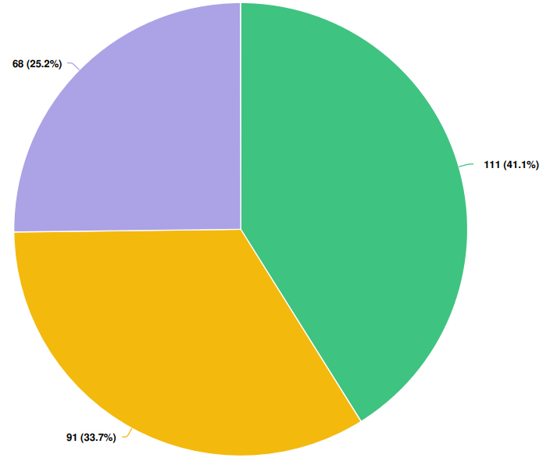
Key Budget Items – Asset Management
Q: Communities across Ontario, including the Town of Cobourg face the ongoing task of replacing aging infrastructure. Would you be willing to pay an additional, dedicated tax levy if you knew these funds would only be drawn upon for infrastructure upgrades?
Note: 2023 Budget Engagement, 28% indicated Yes to this question, 14% stated No and 57% stated they Needed More Information.
2024 Budget Community Engagement Results

Slide 16
Comments and Submissions
Lifeguards at Victoria Beach
A community petition has been started requesting the return of lifeguards at Victoria Beach.
The petition currently has 241 signatures.
2024 Budget Community Engagement Results

Slide 17
THANK YOU
Questions or feedback?
Contact the Communications Department: communications@cobourg.ca 905-372-4301

